Slide 1
Networks R Us Networking Technologies November 2015 by Simon Light

Slide 2
Contents
Network Technologies (P1)
Operating systems
Protocols
Network Layout
Network Devices
Networking Tools
fault management
performance management
using system software to find network assets.
Examples
Emerging network technologies
Advances in robotics
Integrated systems
Global data centre management
Notes:
femerging network technologies, in specific, advances in robotics, integrated systems and global data centre management.

Slide 3
Network Technologies
Notes:
OK so I'm going to start with network technologies.

Slide 4
Operating systems
The role of the operating system is to mange both software and let them work together.
It provides services to a range of devices such as:
Firewalls
Peripherals
Audio jack and speaker capability
Popular OS’s:
Windows(7,8,10)
OS X
Linux(Ubuntu, Mint, Debian)
Android(lollypop, marshmallow, ice-cream sandwich)
Servers (Ubuntu server, Windows Home Server/Business server)

Slide 5
Operating systems
Windows
Windows will be the most common OS to you whether that is 7,8, or most recent, 10. It has a very easy to use UI and is popular across the world.
It is closed source which means only the developers have access to the source code. This means there are fewer distro’s of Windows but they are all complete and finished which is not true of open source OS’s.
Linux
Linux is the most popular free open source OS. It has many distro’s over a wide range from daily use to server management and pen testing#
Linux also supports a wide range of software and devices which is both beneficial(as there is an application for everything) and bad (as not all applications are professionally made and working to the standard they should.

Slide 6
Network Protocols

Slide 7
Network Protocols
Protocols allow communication between devices on a network.
Some examples of protocols are:
CSMA/CD
Local Talk
Token Ring
FDDI
ATM
HTTP/HTTPS
NTP
SMTP
ICMP
SNMPv3

Slide 8
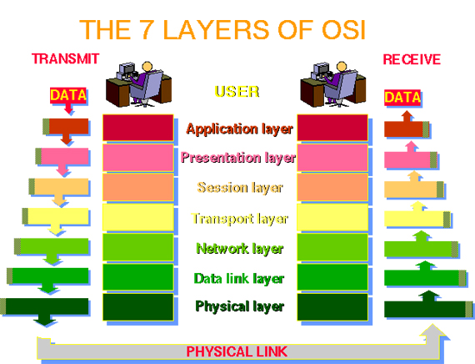
Network Protocols

Slide 9
Network Protocols : SNMPv3
SNMP stands for Simple Network Management Protocol
SNMPv3 is the third version of SNMP.
It includes added security by encrypting data that is transmitted.
SNMP is used for controlling routers and other network devices. It can be used to set up alerts about your network and recorded data such as bandwidth usage.

Slide 10
Network Protocols : HTTP
HTTP stands for Hypertext Transfer Protocol.
It is most commonly used for transferring data over the worldwide web.
HTTP is a 7th layer protocol which means that it runs from an application level.
HTTPS is exactly the same as HTTP except HTTPS contains encryption to avoid the loss of data.

Slide 11
Network Protocols : NTP
NTP stands for network time protocol.
It is used to synchronise the time set on devices across a network.
It uses the time zone of UTC and be as accurate as a fraction of a millisecond.
NTP is needed for security purpose and so that you can access machines remotely.

Slide 12
Network Protocols : SMTP
SMTP stands for Simple Mali Transfer Protocol
It is used to transfer emails including the text, formatting and attachments.
Recently SMTP is only used for sending data to a relay server and not receiving mail (this is done with either POP3 or IMAP)

Slide 13
Network Layouts

Slide 14
Network Layouts
There are two main types of network layouts:
Physical (Wired)
Logical (Wireless)
Wireless networks are used because:
Can be used on the moved/not in fixed position.
Doesn't require as much cabling and trunking.
Almost all devices can support wireless data of some kind.
Wired networks are used because:
They can achieve higher connection speeds.
They are more secure as the user has to be in the building to access the data.

Slide 15
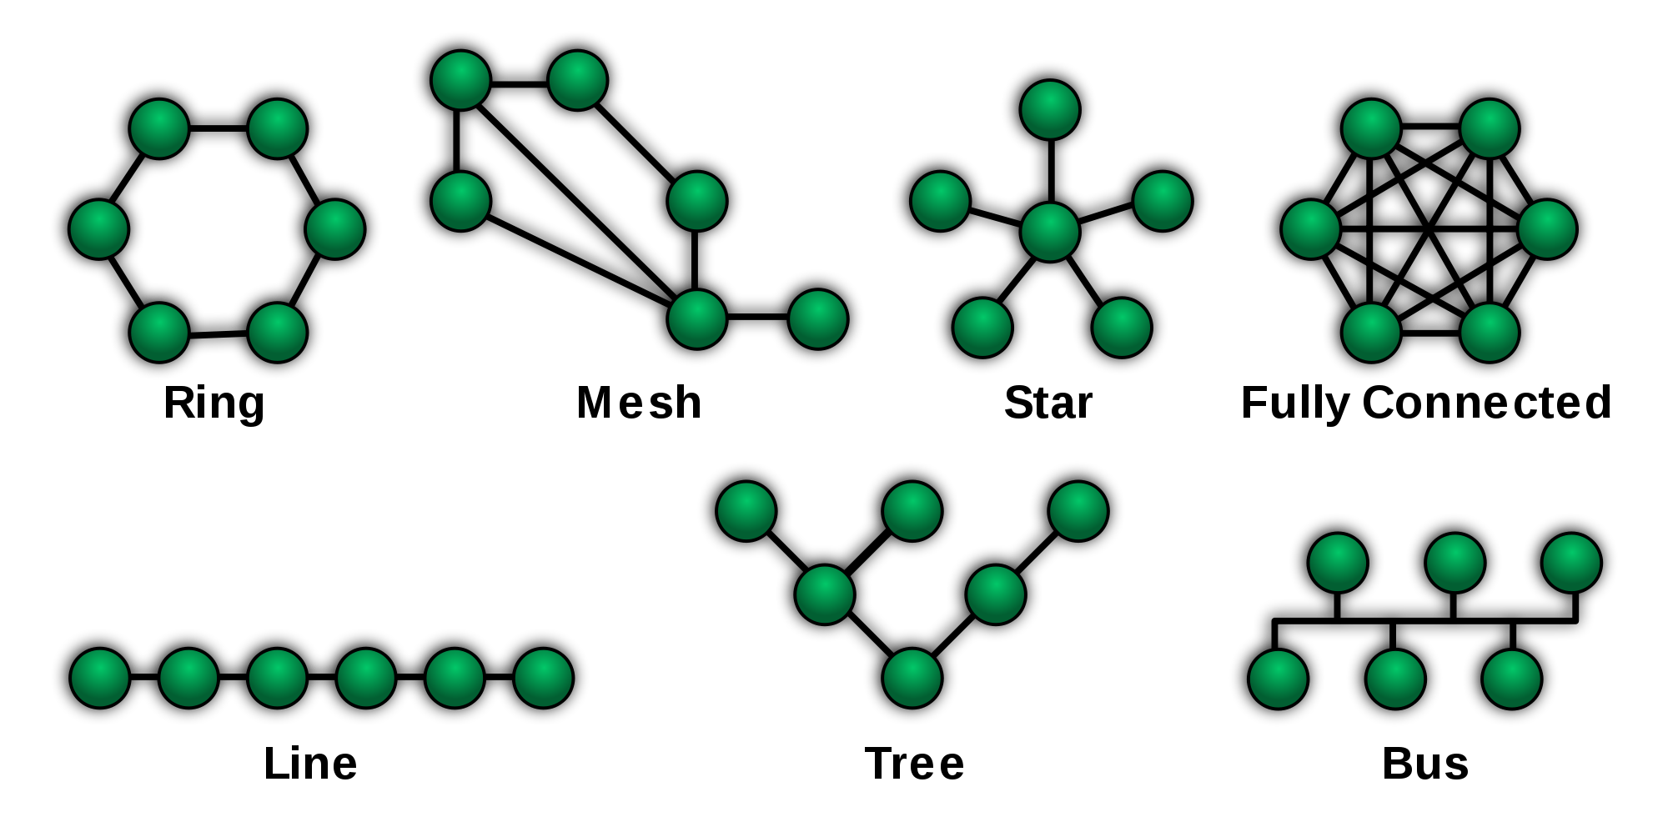
Network Layouts : Star
The star allows for users to connect through one server.
This is useful for network management/monitoring

Slide 16
Network Layouts : Ring
There is no need for a server in this setup.
This allows for fast connections with no venerable points.

Slide 17
Network Layouts : Mesh
Mesh is where each node acts as a relay.
This allows for data to be passed through nodes limiting network setup.
This is useful for ad-hoc servers

Slide 18
Network Layouts : Fully Connected
Fully connected allows for all nodes to be connected directly
This allows for high speed but also high start-up/connections

Slide 19
Network Layouts : Line
The line allows for the most minimal setup.
It is limited on security as the 1st node has to pass data through all of the nodes to get to the last node.

Slide 20
Network Layouts : Tree
Bus allows for the centre line to be very powerful with smaller lines coming off.

Slide 21
Network Devices

Slide 22
Network Devices
Network devices are devices that are used on a network.
Some examples of these are:
Servers
Routers
Switches
Interface card
Workstation

Slide 23
Network Devices : Servers
Servers are used to control and maintain the network.
Servers are just PC’s that have been configured in a specific way. They are also of quite a high specification.
They can be used as:
File servers
Mail Servers
Proxys
Web Servers

Slide 24
Network Devices : Workstations
Workstations are PC’s that are used for a specific job e.g. CAD, rendering etc.
The two main types of workstation are :
Thick Client – OS and applications
Thin Client – Little OS and no/few applications

Slide 25
Network Devices : Interface Cards
Connects a device to a wired internet connection
Can use a radio interface for wireless connection
Can be a plug in card or just a separate device
Uses a unique mac adress

Slide 26
Networking Tools

Slide 27
Networking Tools
Network Tools assist the management and maintenance of a network.
There are three main types:
Fault Management
Performance Management
Detection of Network Assets

Slide 28
Network Tools : Fault Management
This Needs More
Fault management is mainly used for:
Problem Detection
Providing Alerts
Potential to provide automated fixes

Slide 29
Network Tools : Performance Management
This Needs More
Performance management can be used to monitor things such as:
Bandwidth
Latency
Uptime

Slide 30
Network tools : Detection of network assets
This basically just finds assets connected to the network.
This can go as far as:
Finding model/types/specs of the device
Using agents to display what software is installed on the device

Slide 31
Networking Tools : Examples
Wireshark
PsPing
CiscoWorks
Whois

Slide 32
Networking Tools : Wireshark
“Wireshark is the world's foremost network protocol analyser. It lets you see what's happening on your network at a microscopic level. It is the de facto (and often de jure) standard across many industries and educational institutions”.
Wireshark displays traffic that has come through a wired connection. It then displays this information that can be filtered and analysed by the user.
It is useful for checking that the network hasn't got any unwanted traffic.

Slide 33
Networking Tools : PsPing
PsPing measures and monitors the levels of bandwidth, latency and ultimately ping between network devices.
It can also be used to display this information and show which addresses are the biggest and smallest users.
This is good for diagnosing slow areas in the network and improving them.

Slide 34
Networking Tools : CiscoWorks
CiscoWorks can be used to aid the process of administration , configuration, monitoring and general troubleshooting of Cisco based networks.
Examples of this include:
Increased accuracy and efficiency of network maintenance staff.
Quickly identifying possible problems within the network and providing fixes and configuration suggestions to prevent such problems.
Increasing the security of the network by displaying possible entry points.

Slide 35
Networking Tools : Whois
Whois tells the user information about the address it has entered.
The address can either be as an ip (66.193.254.46) or a DNS name (www.sysinternals.com).
It can display information such as : who the device is registered to, where the device is, its ip etc.

Slide 36
Emerging Technologies
This Needs More Detail

Slide 37
Advances in robotics
Robotics in the near future will be boasting fully automated lifelike robots that can complete some quite complex tasks.
This will effect networking in ways such as:
Mundane/low skill tasks such as drive replacement.
Being able to work in conditions not suitable for people (long days etc.)
Being able to send a robot along cable trays/conduit to identify and fix errors.
Being able to be always connected to the network/computer without having to carry a laptop.
Being able to work inside cables (maybe a bit further away).
Working undersea for tasks such as inspecting or pulling cables between countries.
Can be used as a portable wireless access point for workers.
Can be placed in space to work on satellites in very low conditions.

Slide 38
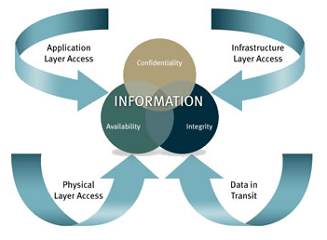
Integrated Systems

Slide 39
Integrated Systems
Integrated systems combine existing systems to create one overarching system that controls everything.
This means that within a building every piece of hardware from radiators to network switches can be controlled from one piece of software.
This means that maintenance of the network can be done remotely and in a lot less time.
Integrated systems also pose the threat of hackers. As of the great power the user has from one computer it means that they are prime targets to hack/steal data from.

Slide 40
Integrated Systems - Examples

Slide 41
Emerging Technologies : Data centre management
For developing businesses, data centres provider a low start-up cost but highly capable solution for storing data.
It means that the business can hand all of their data over to an expert in data management without having to have to directly employ them.
This means that the data centre will use its pre-existing networks and cabling to add your network to.
The disadvantage of this is that the data centre needs to make a profit and so in the long run it will be more expensive than building the network yourself.

Slide 42
Bibliography
http://www.informationweek.com/cloud/10-emerging-it-trends-from-gartner-symposium/d/d-id/1322569?_mc=RSS_IWK_EDT&image_number=9
https://www.edrawsoft.com/Network-Protocol.php
http://homepages.uel.ac.uk/u0415051/OSI%20MODEL/
http://www.cisco.com/c/en/us/td/docs/ios-xml/ios/snmp/configuration/xe-3se/3850/snmp-xe-3se-3850-book/nm-snmp-snmpv3.html
http://www.networkmanagementsoftware.com/snmp-tutorial
https://en.wikipedia.org/wiki/Hypertext_Transfer_Protocol
http://searchnetworking.techtarget.com/definition/Network-Time-Protocol
https://en.wikipedia.org/wiki/Simple_Mail_Transfer_Protocol
https://en.wikipedia.org/wiki/Network_topology
https://www.wireshark.org/
https://technet.microsoft.com/en-us/sysinternals/psping.aspx

